Slide 1
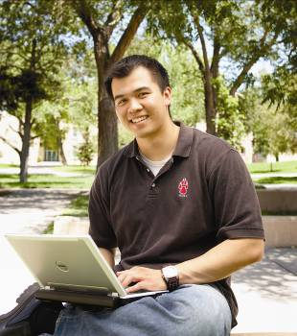
Engine for STEM Education, Research, and Economic Development
The UNM School of Engineering
Christos Christodoulou
Associate Dean for Research
Dean Designate
School of Engineering
June 16, 2017
New Mexico Society of Professional Engineers

Slide 2
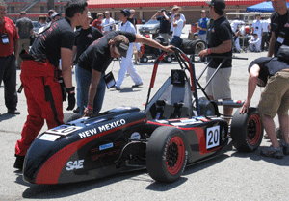
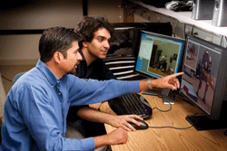
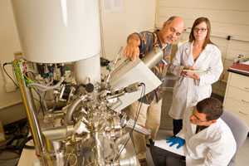
Primary Mission
The School of Engineering Delivers STEM Education in a Research-Driven, Practice-Oriented Environment

Slide 3
Faculty, Funding, Enrollments, and Degrees
FACULTY (187)
Current Major Operating Funding
Tenure Track
100
State of NM and tuition
$16.1M
Lecturers
10
Research Funding (Ext contracts)
$33.0M
Adjunct
30
Research Funding/TT Fac.
$330k
Research
49
Degree | SOE AY 15-16 Enrollment
BS | 2314
MS | 432
PhD | 421
Total | 3167
Degree | SOE AY 14-15 Degrees
BS | 227
MS | 154
PhD | 64
Total | 445

Slide 4
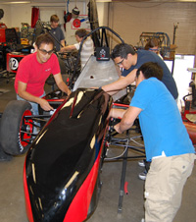
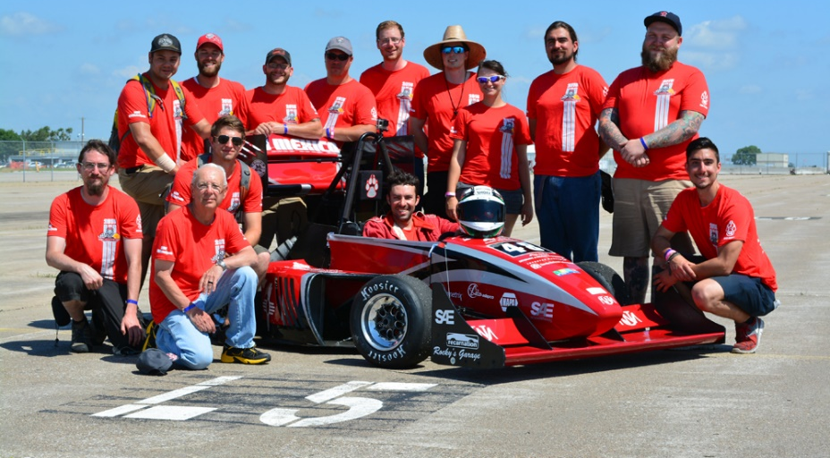
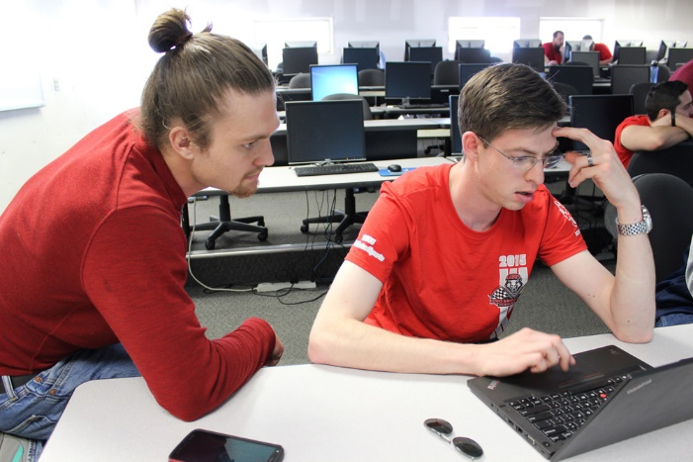
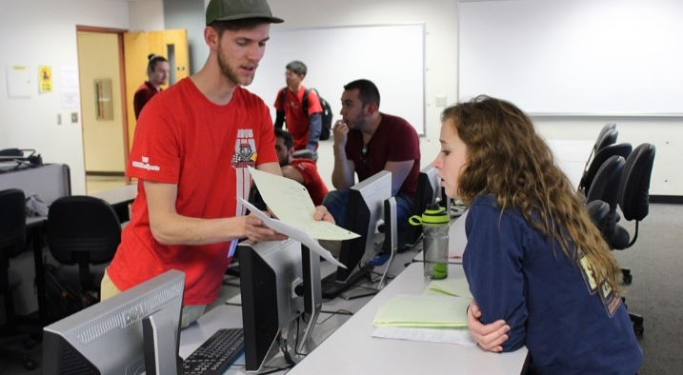
Undergraduates in all programs work on exciting capstone design projects
The Formula SAE (FSAE) race car project

Slide 5
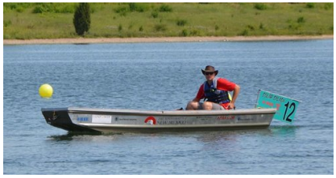
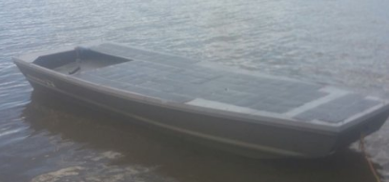
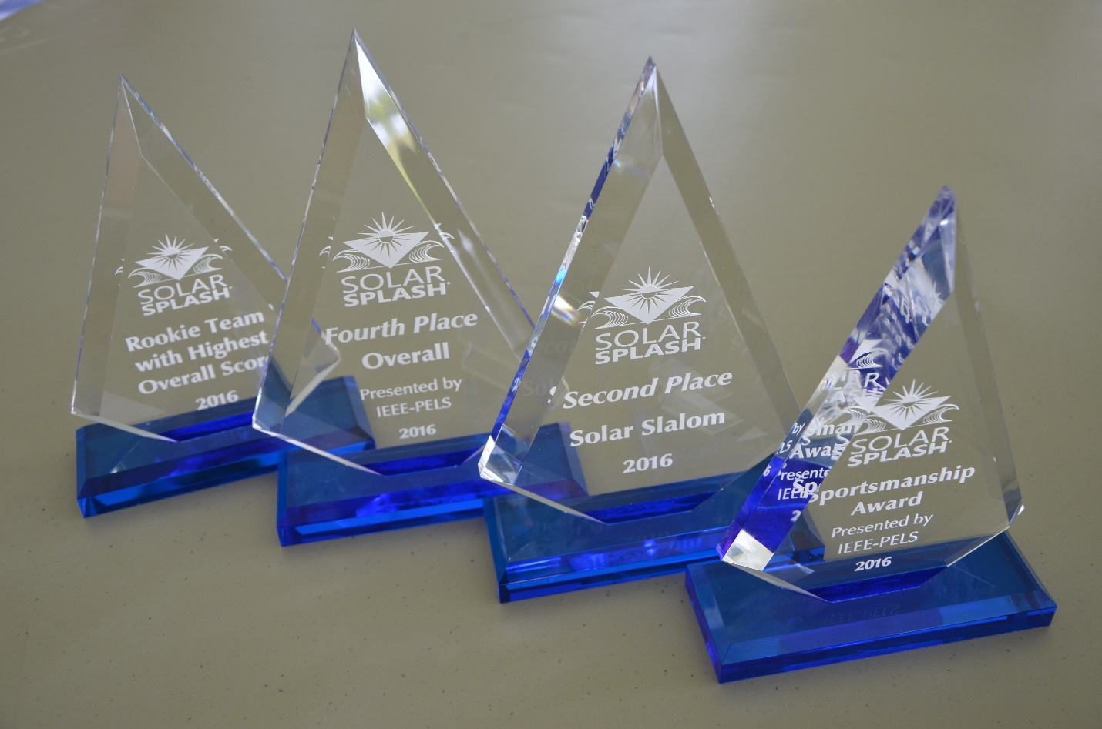
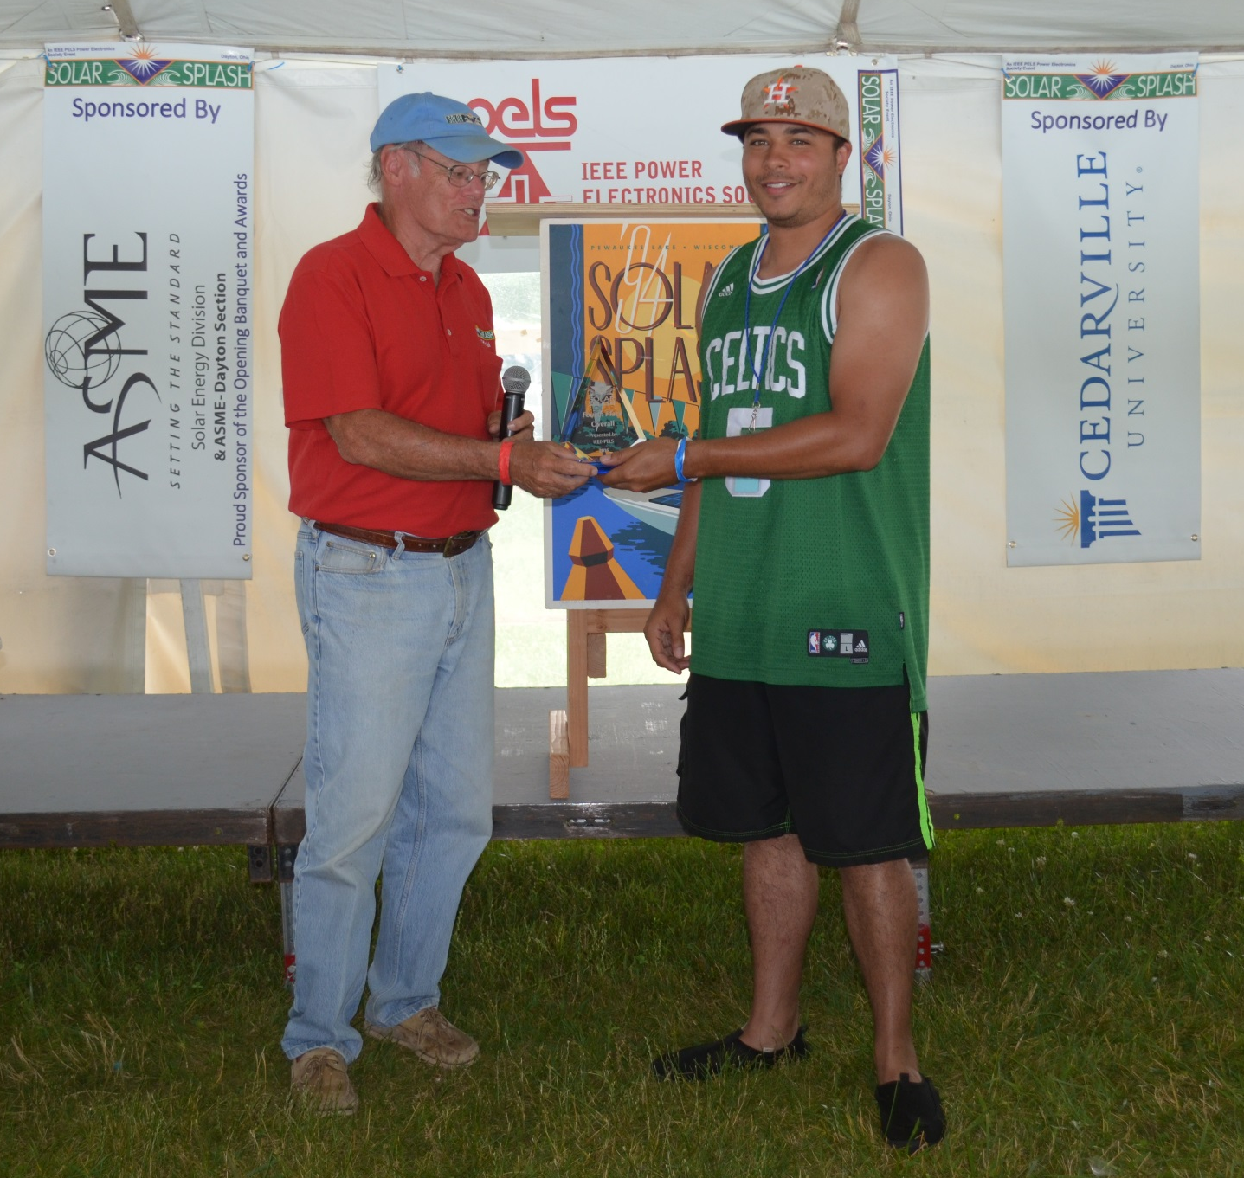
Solar Splash: Intercollegiate Solar Boat Regatta
Alternative Energy Education & Teamwork
Events
Joint ECE
& ME Team
Solar
Panels
Sprint
Maneuverability
Solar Slalom
Visual Displays
Workmanship
2016 UNM “Jolly Roger”
The 2016 Rookie UNM Team placed:
2nd in Solar Slalom/4th overall (4/13)
Top-scoring Rookie team (1/5)
Won the Sportsmanship Award!
UNM ECE UG Joshua Stewart receiving
the 2016 Solar Splash Sportsmanship Award

Slide 6
The School of Engineering is structured for STEM student success and community engagement
6 Academic Departments
Chemical & Biological Engineering
Civil Engineering
Computer Science
Electrical and Computer Engineering
Mechanical Engineering
Nuclear Engineering
Engineering Student Services
8 Affiliated Interdisciplinary Degree Programs
9 Affiliated Research Centers
Degree Programs:
9 BS (accredited)
13 MS
10 PhD

Slide 7
SOE Research Thrusts Align with Areas of Exciting Commercial Application
Aerospace Science and Engineering
Biomedical Engineering, Bioinformatics, Biocomputing
Energy, Environment, Water
Sustainable and Resilient Infrastructure
Integrated/Additive Manufacturing and Robotics
Nanoscience, Nanotechnology, Microsystems
Photonics and Optics
Scalable Computing and Cyber Security
Nuclear Non-proliferation and Safeguards

Slide 8
Major Research Activities are Well-Integrated with Academic Degree Programs
Research Organizations
Center for High Technology Materials
Center for Micro-Engineered Materials
Center for Biomedical Engineering
Center for Emerging Energy Technology
Manufacturing Technology and Training Center
Configurable Space Microsystems Innovations and Application Center (COSMIAC)
Center for Water and Environment
Center for Advanced Research Computing
ARTS Lab (computing, visualization)
Academic Programs
Optical Science and Engineering (SOE, A&S)
Nanoscience and Microsystems (SOE, A&S)
Biomedical Engineering (SOE, SOM, COP, A&S )
Aerospace Science and Engineering
Manufacturing Eng (SOE, ASM)
Water Resources (UC, SOE, A&S, SOL, SAP)
Integrated Film and Digital Media (SOE, CFA, A&S, ASM, SAP)
Computational Science and Engineering (SOE, A&S)

Slide 9
The School of Engineering is a vital and engaged partner in strategic collaborations
UNM Schools and Colleges, particularly, College of Arts & Sciences, College of Fine Arts, School of Medicine, College of Pharmacy, and Anderson School of Management
STC.UNM (UNM’s Tech xfer org.)
Sandia National Laboratories
Los Alamos National Laboratory
Air Force Research Laboratory
Idaho National Laboratory
Local and National Companies

Slide 10
In partnership with STC.UNM, SOE research leads to invention and innovation
Total FY12-16 SOE Metrics
Invention Disclosures | 316
Issued US Patents | 128
License Revenue | $10.5M
Startups | 21
UNM is among the Top 100 Worldwide Universities granted U.S. patents in 2016 at No. 33.

Slide 11
Joint IP with the National Labs
 | Sandia | Los Alamos
Joint Patents | 173 | 39
Commercialization Agreements | 74 | 23
Total Start Ups from Joint IP | 7

Slide 12
Number of Fellows
National Academy of Engineering - 1 Member
Institute of Electrical and Electronic Engineers - 12 Fellows American Astronautical Society - 1 Fellow
American Society of Mechanical Engineers - 5 Fellows American Nuclear Society - 2 Fellows
American Vacuum Society - 1 Fellow
American Institute of Chemical Engineers - 2 Fellows
Int. Assoc. for Advancement of Space Safety - 1 Fellow Optical Society of America - 3 Fellows
Microscopy Society of America - 1 Fellow
American Society of Civil Engineers - 1 Fellow
PECASE Awards – 2 since 2000
R&D 100 Awards – 4 since 2012

Slide 13
Vision for our School
My vision is to guide the School of
Engineering and Computing to true
national prominence
and
help our school become
known for the richness of its teaching and
for its excellence in research

Slide 14
Goal#1: Faculty and Student Growth
Most critical challenge!!!
Our school has not grown significantly in Faculty numbers for the last 15 years.
We have been stuck at around 100 tenured and tenure-earning Faculty members.
We have only added a small number of lecturers and adjunct professors
Our research expenditures have not changed much in the last 15 years, despite the hard work of our faculty.
We were about $30–31M in 2002 and we are $33M this year!

Slide 15
Goal Add a minimum of 25 new faculty lines in the next 5 years
Urgency & Good News
The Provost initiated a new formula: Colleges get most of the tuition money back
We can add, roughly, a new faculty line to SOE for every 25-30 undergraduate/graduate students that we add to our School enrollment.

Slide 16
Student population
Undergraduates: 2,314
MS: 367, PhD: 787 Total grad: 1,157
Total students 3,468
Goal: Increase enrollment to at least 3300 undergraduate students in the next 5 years!!!
We can do it and exceed it

Slide 17
An increase in the number of students will lead to an increase in the number of faculty
We can grow beyond the $40-45M mark in research in 5 years!
An increase in the number of faculty will lead to an increase in research and graduate students
Higher Rankings!
Circle of Growth
An increase in the number of grad students will lead to an increase in the number of faculty and more research
17

Slide 18
Some actions to increase enrollments
1- Refocus our recruiting message and student communications on the mobile platform.
2- Enhance our efforts in out of state recruiting
3- Enhance our Engineering Honors program.
4- Develop online programs that will help us recruit and retain more students.
5- High School Summer Programs

Slide 19
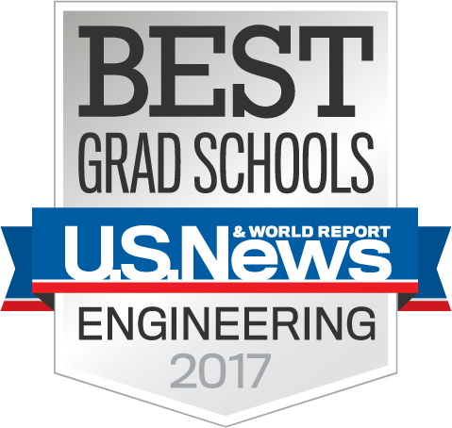
Goal#2:Visibility and National Rankings
SOE has some truly amazing and successful Faculty in
terms of teaching, research, and community impact!
It is not that SOE has a bad reputation.
We lack critical mass in most research areas.
Higher rankings and more visibility will help us with recruiting efforts, growth, and research endeavors.
Higher rankings will also help us attract more engineering and computer science companies to NM.

Slide 20
Some actions to increase visibility & Rankings
Establish a committee to study the formula and all criteria used into ranking programs by the US News & World Report.
Engage into an active campaign to promote some of our Distinguished Faculty to become members of the National Academy of Engineering/Science.
Invite other Deans to visit SOE.
We are #99 now
My Goal: Become top 50 !!!

Slide 21
Goal#3: Increase Research, Better strategic planning and industry collaboration
The average research expenditures per faculty is $300k/year.

Slide 22
Strategic research planning
Focus in a few strategic areas that are important to the State of New Mexico.
Examples: Cybersecurity/IoT, Smart Energy, Bioengineering, Water…
With 25 or more faculty in the next 5 years and some new industry/national lab partnerships we should reach $40–45M a year in research expenditures.

Slide 23
Goal #4: Fundraising and diversifying our streams of revenue
Last year alone, US Colleges raised $40.3 billion in donations (7.6% over the previous year!) .
Scholarships Endowments
MUST increase and deepen our corporate relationships
and sponsorships.

Slide 24
Goal #5: Entrepreneurial innovation and activities
Need to help more with the economic development in the State of New Mexico.
Continue working with
STC.UNM
Innovation Academy
The Anderson School of Management
Innovate ABQ
SOE should be transformed into a Center for Innovation and Networking for many small and large companies in New Mexico

Slide 25
Questions???

