Slide 1
NEW MEXICO SOCIETY OF PROFESSIONAL ENGINEERS 2017 ANNUAL MEETING
Tim Austin, PE, F.NSPE
Past President (2015-16)
National Society of Professional Engineers

Slide 2
Transcending the
Professional Engineer

Slide 3
Is Engineering Licensure still relevant in today’s economic world?

Slide 4
The Dichotomy of Engineering
Engineers focus on tools and solutions that help people to help themselves.
In other words, engineers must ask themselves, "How can I make myself irrelevant?"

Slide 5
The Professional Engineer
Licensed engineers continue their commitment to protecting the health, safety, and welfare of the public through demonstrated competency and subjecting themselves to a code of conduct backed by the force of law.
To a client, it means you've got the credentials to earn their trust.
To an employer, it signals your ability to take on a higher level of responsibility.
To the regulator, it means competency.

Slide 6
What does it mean to the public?

Slide 7
The Non-Engineer Perspective
Non-technical or technologist can be as qualified or suitable substitute
Licensed professionals cost more
Turf protection
Certifications are sufficient protection
Codes, standards and regulations provide acceptable protection
Lack of awareness or understanding as to PE

Slide 8
What does your license mean to YOU?

Slide 9
The Professional Engineer
To yourself, it's likely a symbol pride and measure of your own hard-won achievement.
BUT IT IS MORE
Willingness to accept risk
Willingness to serve
Willingness to be accountable

Slide 10
PE is our badge of honor. It publicly symbolizes personal pride, integrity, responsibility, commitment.

Slide 11
But can it mean even more?

Slide 12
NSPE Code of Ethics
Preamble
Engineering is an important and learned profession. As members of this profession, engineers are expected to exhibit the highest standards of honesty and integrity. Engineering has a direct and vital impact on the quality of life for all people. Accordingly, the services provided by engineers require honesty, impartiality, fairness, and equity, and must be dedicated to the protection of the public health, safety, and welfare. Engineers must perform under a standard of professional behavior that requires adherence to the highest principles of ethical conduct.

Slide 13
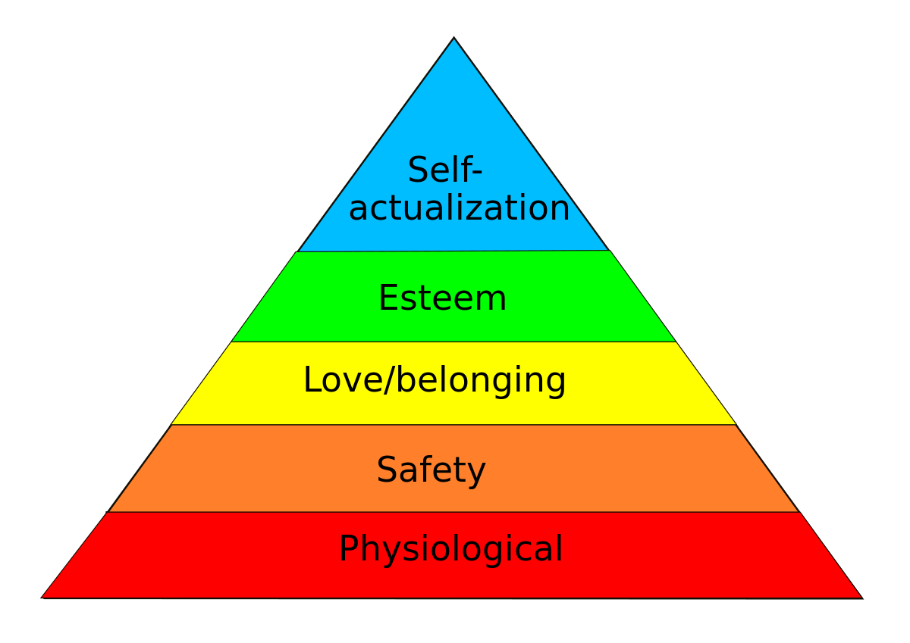
MASLOW’S HEIRARCHIY OF NEED

Slide 14
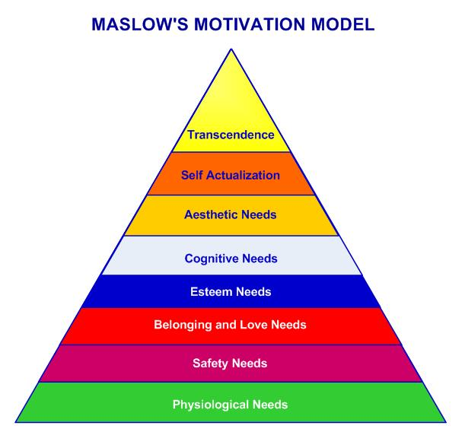

Slide 15
Transcendence -
That is, such individuals seek a benefit beyond the purely personal and seek communion with the transcendent, perhaps through mystical or transpersonal experiences; they come to identify with something greater than the purely individual self, often engaging in service to others.

Slide 16
NSPE Code of Ethics
“…..adherence to the highest principles of ethical conduct.”

Slide 17
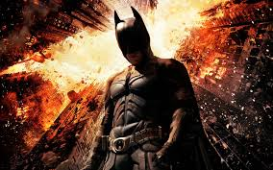
Have “we” given everything?

Slide 18
Growing chorus that engineers are not doing enough for humanity.

Slide 19
Chronicle for Higher Education
“Fools for Tools”,
by John Kaag and Sujata Bhatia, PE.
“We worry that the many conveniences delivered by modern engineering makes citizens loath to interrogate the moral implications of technological progress.”

Slide 20
NSPE Code of Ethics
I. Fundamental Canons Engineers, in the fulfillment of their professional duties, shall:
Hold paramount the safety, health, and welfare of the public.
“If we take this canon seriously, it implies something counterintuitive about the skill set of tomorrow’s engineers, namely they should be experts in discussing and determining what constitutes the common good.” ~ Ibid

Slide 21
NSPE Code of Ethics
III. Professional Obligations
Engineers shall at all times strive to serve the public interest.
a. Engineers are encouraged to participate in civic affairs; career guidance for youths; and work for the advancement of the safety, health, and well-being of their community.
“Encouraged? That tepid suggestion fails to reflect the nature of the obligation that engineers should have to their fellow citizens”. ~ Ibid

Slide 22
NSPE Code of Ethics
I. Fundamental Canons Engineers, in the fulfillment of their professional duties, shall:
6. Conduct themselves honorably, responsibly, ethically, and lawfully so as to enhance the honor, reputation, and usefulness of the profession.
“The call to conscience of the final canon…might be regarded as a moment of wishful thinking or as the lynchpin that ensures that all of the other, more specific tenets of its ethical code will be followed”. ~ Ibid

Slide 23
“Engineers bear a responsibility to consider both nontechnical and technical solutions to societal challenges. Because engineers have the skills to bring their visions to fruition, the engineer is both an arrowsmith and archer, shaping the future direction of society. The key question for the engineer is: What kind of society am I creating?”
~ Ibid

Slide 24
The Great Reversal
- How We Let Technology Take Control of the Planet
By David E. Tabachnick
“the occasion for the writing this book is the related concern that the increasing technological character of the world is somehow threatening the future of humanity”.

Slide 25
“On the surface it makes sense that only those who fully understand the complexities of a technology – who know what it can and cannot do – are qualified to make decisions about its larger health and societal effects. In turn, legislators and regulators should heed the advice of the technologists and develop and enforce appropriate laws and prohibitions.”
~ Tabachnick

Slide 26
“For Aristotle, to be ethical was more than simply knowing right from wrong, but also meant the capacity to act upon the knowledge.”
~ Ibid

Slide 27
What role should professional engineers play in technological change?

Slide 28
EXAMPLES
AUTONOMOUS VEHICLES
ARTIFICIAL INTELLIGENCE
GENE EDITING
TRANSHUMANISM
INTERNET OF THINGS

Slide 29
Bill Joy, co-founder Sun Microsystems
“We have yet to come to terms with the fact that the most compelling 21st century technologies pose a different threat than the technologies that have come before”.
~ Why the Future Doesn’t Need Us, Wired Magazine, 2000

Slide 30
Stephen Hawking, physicist
"The development of full artificial intelligence could spell the end of the human race.“
~ As reported by the BBC, December 2014

Slide 31
Elon Musk, founder Tesla Motors and SpaceX
Musk who was speaking at the Massachusetts Institute of Technology (MIT) Aeronautics and Astronautics department’s Centennial Symposium said that in developing artificial intelligence (AI) “we are summoning the demon.”
“I’m increasingly inclined to think there should be some regulatory oversight maybe at the national and international level, just to make sure that we don’t do something very foolish”. ~ Elon Musk

Slide 32
Bill Gates, co-founder Microsoft
"I am in the camp that is concerned about super intelligence. First the machines will do a lot of jobs for us and not be super intelligent. That should be positive if we manage it well.
"A few decades after that though the intelligence is strong enough to be a concern. I agree with Elon Musk and some others on this and don't understand why some people are not concerned."
~ As reported by the BBC, January 2015

Slide 33
As technological advances increase, it is apparent more than ever before that licensed professional engineers need to take a leadership role in the ethical development, application and use of technology.

Slide 34
“They didn't understand what they were doing. I'm afraid that will be on the tombstone of the human race.”
~ Michael Crichton, author

Slide 35
How will you transcend as a Professional Engineer?
www.nspe.org @NSPE_HQ @TimAustin_PE

