Slide 1
Nuclear – In or Out? Up or Down?
Robert Busch, Ph.D, P.E.
Presentation to NM Society of Professional Engineers June 16, 2017

Slide 2
Nuclear
What does this bring to mind?
Waste
Weapons
Radiation
Expensive
Accidents
Risk

Slide 3
Risk vs. Benefit
Most of the terms represent the risks
As with all activities there are
Risks associated with Benefits
How did this evolve from nuclear weapons?

Slide 4
Atoms for Peace (Dec. 1953)
President Eisenhower spoke before the United Nations
To enlighten the world on the risks and hopes of a nuclear future
Eisenhower's speech was aimed at "emotion management", balancing fears of continuing nuclear armament with promises of peaceful use of uranium in future nuclear reactors.
Started the international focus on peaceful uses of atomic energy; a refocus after the use and testing of nuclear weapons.
Resulted in the creation of the International Atomic Energy Agency (IAEA)

Slide 5
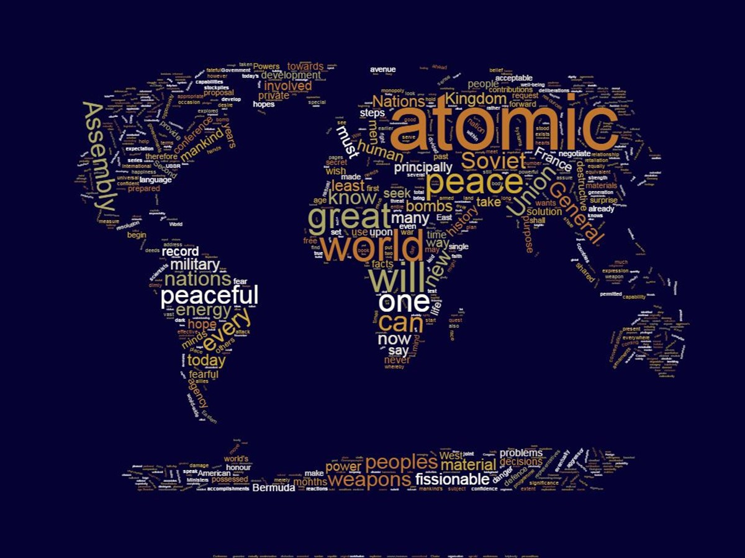

Slide 6
Risk vs. Benefit
What is Nuclear?
What are the benefits and the risks?

Slide 7
Nuclear
Relating to the nucleus of an atom
The utilizing of energy and / or radiation emitted from the nucleus
Most often applied to nuclear energy from fission (splitting the nucleus) – used to generate electricity

Slide 8
E = m c ²
Nuclear processes involve the conservation of mass-energy
1 gram of mass =
90 mega MJ of energy
20 kilotons of chemical energy

Slide 9
Other Applications of Nuclear
Industrial
Agricultural
Medical
Science
Small Power Sources (“batteries”)

Slide 10
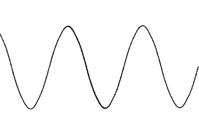


Attenuation of Radiation
The amount of radiation penetrating an object depends on the type and energy of the radiation, and the thickness and density of the object

Slide 11
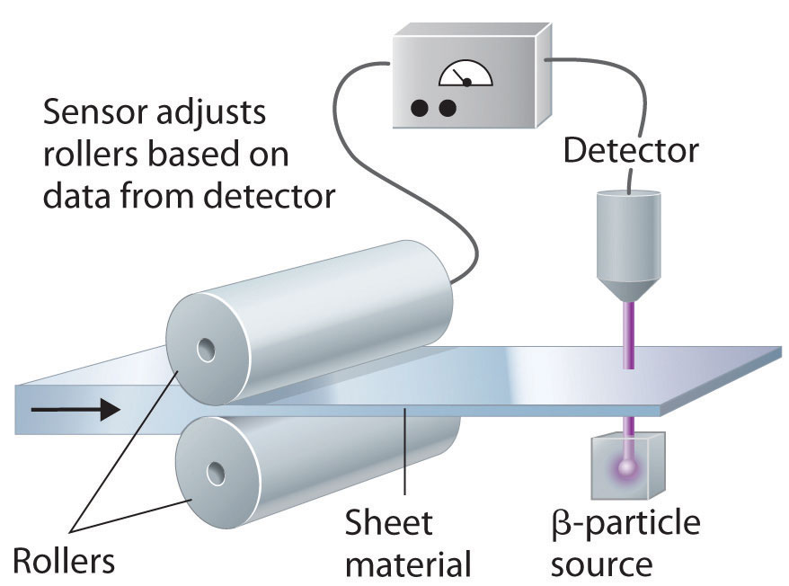
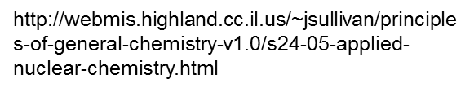
Industrial Thickness gauge
Thickness Gauging
Al foil
Plastic Film
Height of Liquid in Tank

Slide 12

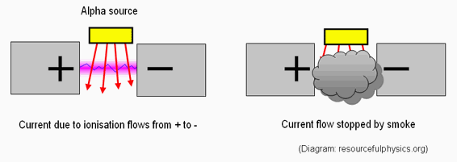
Industrial
Smoke
Detectors
http://tap.iop.org/atoms/radioactivity/509/page_47071.html

Slide 13
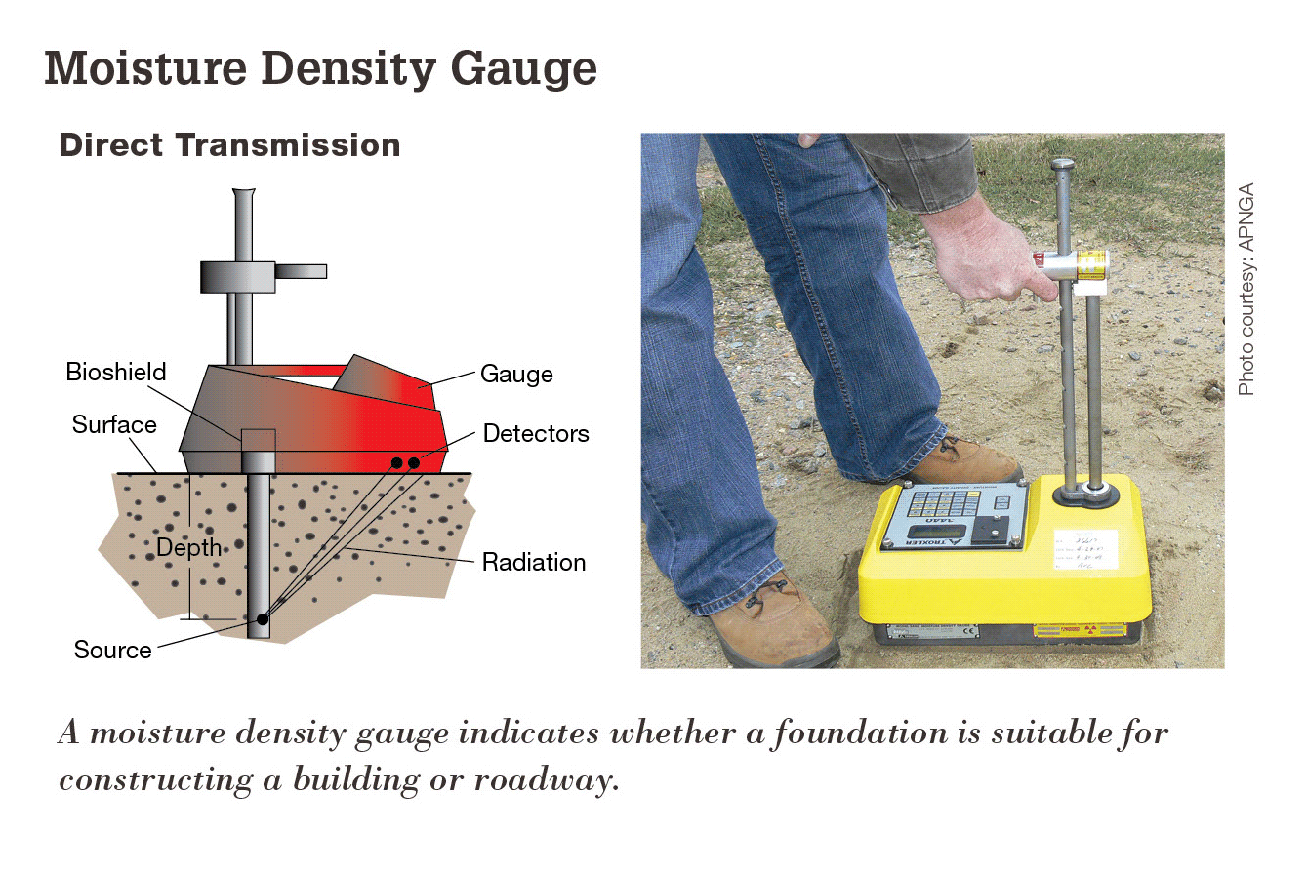
Industrial
Soil Density, Moisture Gauge
https://www.nrc.gov/materials/miau/industrial.html

Slide 14
Sterilization
Medical Products
  syringes, gloves, clothing, instruments
Wool
Spices
Food
  used since 60s, approved in 41 countries for 220 different foods.

Slide 15
Tracers
Radioactive and Non-radioactive forms of an element are chemically similar.
Used to trace flow and uptake of tagged chemical (organics, sodium, iodine, etc.)

Slide 16
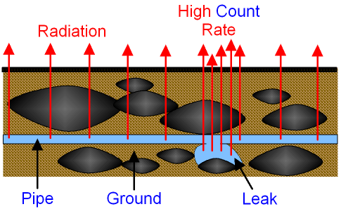
Leak Detection
Count Rate increases in area where pipe is leaking
http://www.gcsescience.com/prad27-radioactive-tracer.htm

Slide 17
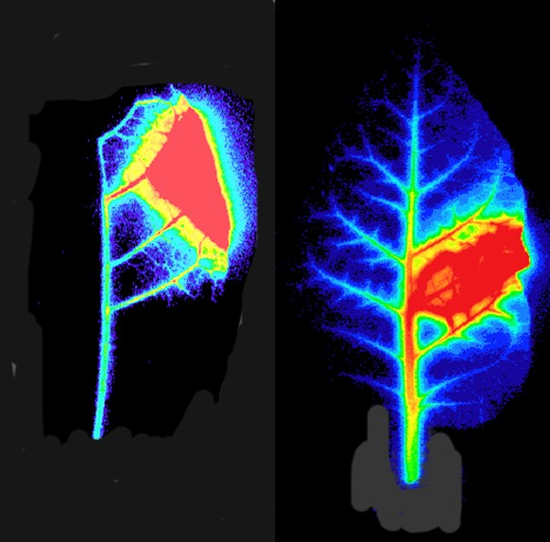
Agriculture
How water and nutrients move through soils and plants.
https://sites.google.com/site/internationalgcsephysics/section-7-radioactivity-and-particles/b-radioactivity/5-uses-and-dangers-of-radiation

Slide 18
Tracers – Other Applications
Mixing efficiency in industrial processes
Soil movement, moisture, and impact of agriculture
Flow rates of liquids or gases in pipelines
Sewage or contaminants into waterways

Slide 19
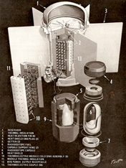

Science
Age determination
  Rocks, Trees, Bones
Groundwater Replenishment
Power for Satellites - RTG
Low Power Batteries
http://techatmech.blogspot.com/2015/09/nano-nuclear-batteries-beta-voltaic.html

Slide 20
Medical
Diagnostic – Tc-99m 80% of all nuclear medical processes (30 million/year, 50% of these in North America)
Therapeutic
  Gamma Knife – external irradiation
  I-131 for Thyroid Cancers – internal
  I-125 or Pd-103 for Prostate Cancer - internal

Slide 21
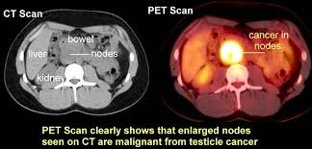
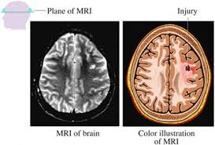
Medical Imaging
PET imaging
Metabolic
MRI
http://www.aboutcancer.com/testiclea.htm
http://www.wkhs.com/Cancer/Cancer-Treatment-Services/Imaging-Services/Magnetic-Resonance-Imaging-MRI.aspx

Slide 22
Nuclear Power

Slide 23
Producing Electricity
Electricity is produced in a generating plant.
Simple generator - two main components:
  a rotating magnet called the “rotor” which turns inside stationary coils of copper wire called the “stator.”
Generating plants must use some form of energy or fuel to turn the rotor.

Slide 24
Producing Electricity (cont’d)
Energy is used to create steam to turn the blades of a turbine that spins a generator, producing electricity.
Energy to create steam from fossil fuels — coal, oil, or natural gas or from nuclear.
Energy to spin rotor from wind, solar, hydro, or geothermal.
Direct conversion with photovoltaic solar.

Slide 25
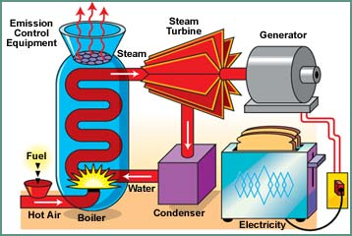
Producing Electricity (cont’d)

Slide 26
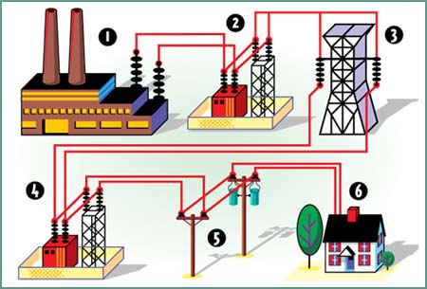
Transmission & Distribution

Slide 27
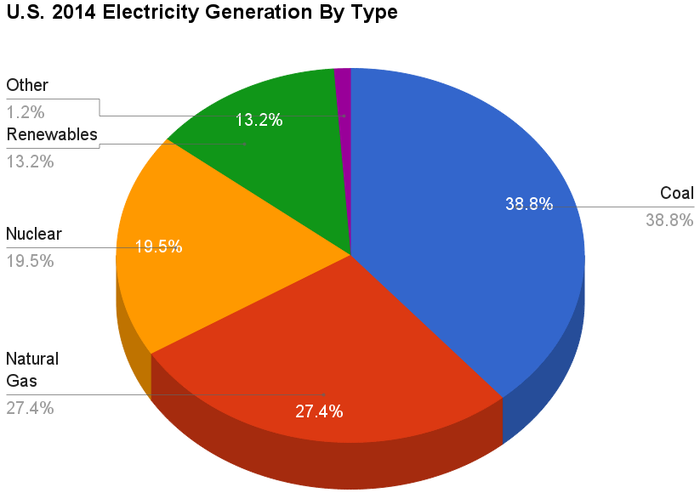

Slide 28
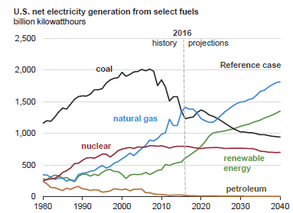

Slide 29
Status of Nuclear Power
Currently 450 reactors in operation in 30 countries.
60 new reactors under construction
Provide 11% of world’s electricity
Continuous source of reliable, base power without CO₂ emissions.

Slide 30
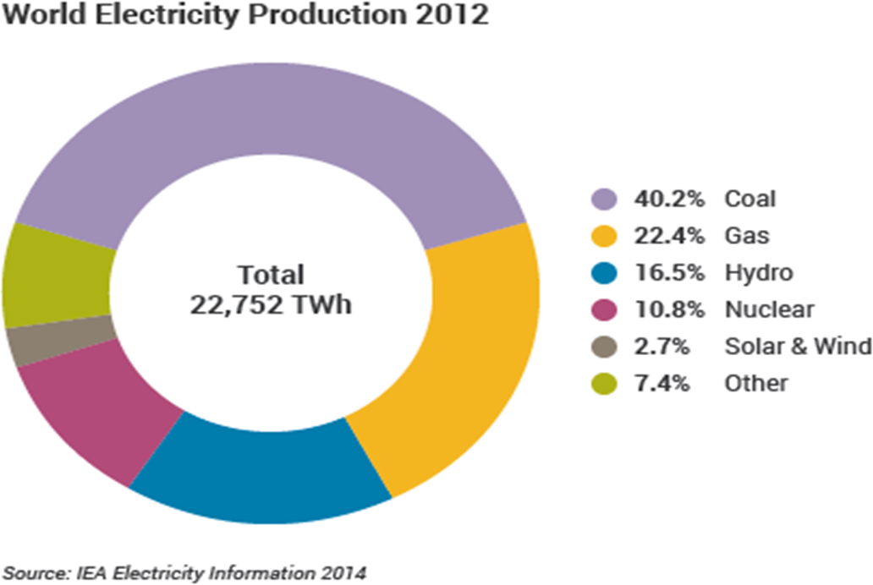
World Electricity Production 2012
By Source

Slide 31
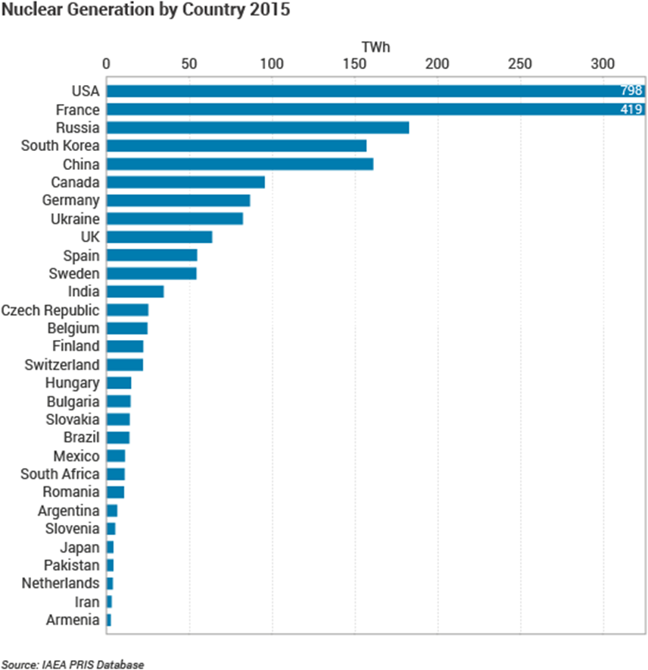
Total TWh Nuclear Generation by Country 2015

Slide 32
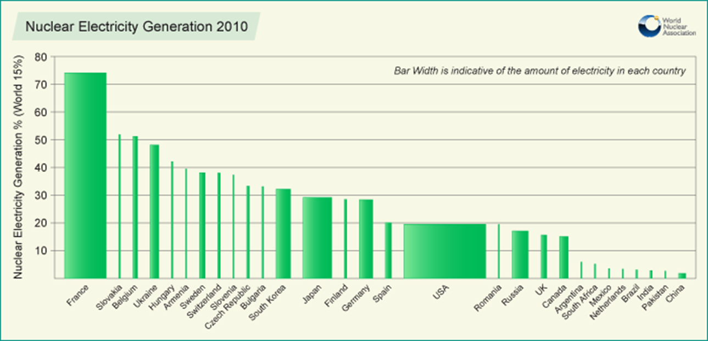
Percent Generated By Nuclear

Slide 33
Fraction from Nuclear
At least 16 countries get 25% or more of their electricity from nuclear
France gets over 70%
South Korea over 32%
US about 20%
China about 4%

Slide 34
China Electricity Generation
Coal – 64.1% (1055 GWe installed), 21 new plants (165 GWe) under construction
Other Fossil – 8.0% (131.7 GWe)
Nuclear – 3.5% (57.6 GWe), 21 new plants (21.5 GWe) under construction
Renewables – 5.0% (82.3 GWe)
Hydro – 19.4% (319.2 GWe)

Slide 35
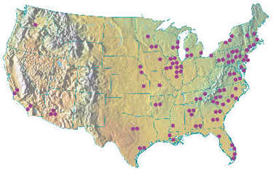
Nuclear Power in the United States
~20% Nuclear Energy
99 Nuclear Reactors
  30 States
  34 BWRs
  66 PWRs
Largest Plant
  Palo Verde
  3825 MWe/3 reactors
  12th Largest in World
http://www.nei.org

Slide 36
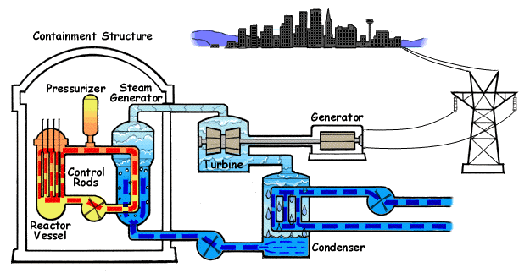
Basic Diagram of a PWR
http://www.nrc.gov/

Slide 37
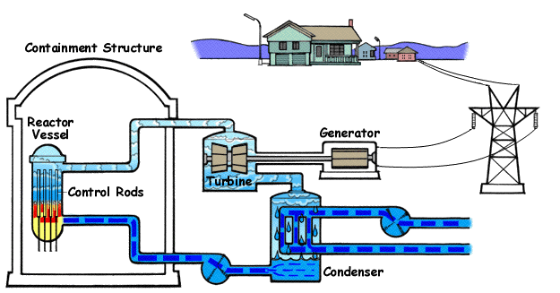
Basic Diagram of a BWR
http://www.nrc.gov/

Slide 38
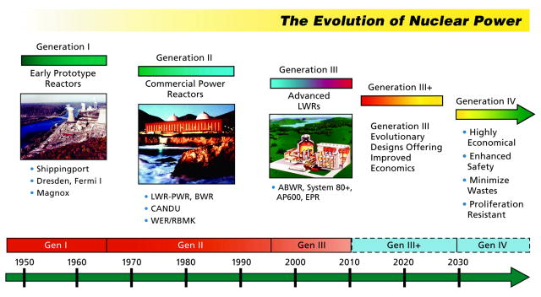
Reactor Generations
http://www.whitehouse.gov/

Slide 39
Defense in Depth Safety Philosophy
Barrier to Prevent Release of Radioactivity to the Environment
  Fuel Pellet
  Fuel Cladding
  Reactor Coolant
  Reactor Pressure Vessel
  Primary Containment
  Secondary Containment

Slide 40
Next Generation Reactors
Passive Safety – no active intervention needed to avoid accidents.
Simpler designs, more fuel efficient
4 currently under construction in the US
  Two at Vogtle in Georgia (1200 MWe)
  Two at VC Summer in South Carolina (1200 MWe)

Slide 41
Small Modular Reactors (SMR)
Small is less than 300 MWe
Driven both by a desire to reduce the impact of capital costs and to provide power away from large grid systems.

Slide 42
SMRs as Coal replacements
SMRs more readily fit to replace decommissioned coal-fired plants
In the USA coal-fired units retired over 2010-12 averaged 97 MWe, and those expected to retire over 2015-25 average 145 MWe.

Slide 43
Nuclear as Sustainable
Renewable energy sources (primarily wind and solar) will not be able to supply the needed large quantities of energy sustainably, economically and reliably.
In addition, renewable energy sources with fossil-fired backup power will in many cases not contribute towards reduction of greenhouse-gas emissions

Slide 44
Nuclear as Sustainable
Intermittent energy sources with stored-energy facilities might, in some cases be economically viable, particularly for isolated locations without access to an electric grid.
But the major contribution in terms of replacing the global use of coal, oil and gas must come from a large-scale deployment of nuclear fission energy, with a goal for full fuel recycling for maximum long-term sustainability of this critical zero-carbon energy source.

Slide 45
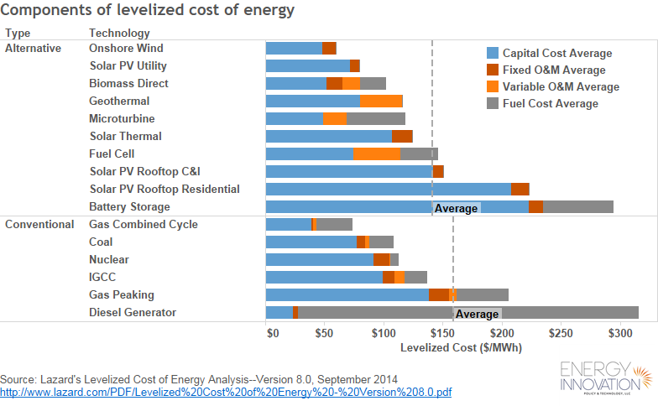

Slide 46
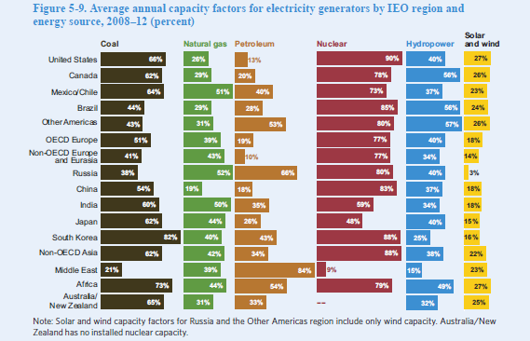

Slide 47
Cost per MWh supplied
Wind - $70 / 0.27 = $259
Solar PV utility - $83 / 0.27 = $307
Coal - $115 / 0.66 = $174
Nuclear - $120 / 0.90 = $133
Capacity Factor applied

Slide 48
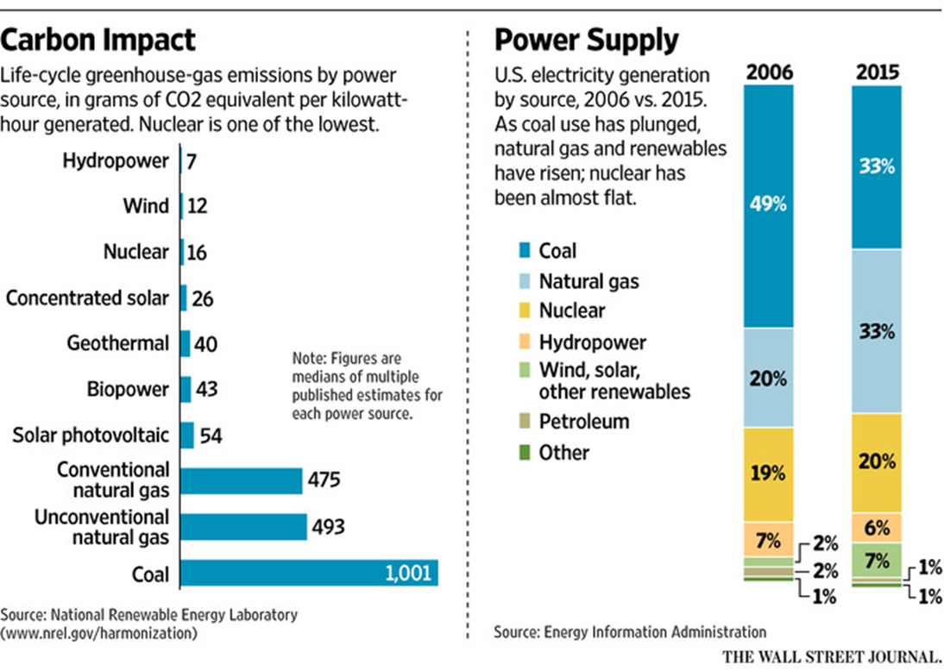
Carbon Impact by Source

Slide 49
800 lb gorrilla(s)
Nuclear Power Accidents (3 of note)
Three Mile Island (March 1979)
Chernobyl (April 1986)
Fukushima (March 2011)

Slide 50
Three Mile Island
Three Mile Island (March 1979) – normal reactor trip, operator actions made situation worse.
Partial Core melt
No deaths or injuries, minimal radiation release
Psychological impact on public

Slide 51
Chernobyl
Occurred during an experiment to test alternate cooling methods.
Poor reactor design and human error led to steam explosion and significant radiation release.
Reactor design used only in former Soviet Union.

Slide 52
Chernobyl
Deaths: 56 direct (47 workers, 9 children) - could be an extra 4,000 cancer deaths among the 600,000 exposed
Significant radiation released into upper atmosphere
Measureable around the world.

Slide 53
Fukushima
Earthquake and subsequent tsunami
Quake knocks out off-site power connections – so On-site Diesel Generators provide electricity for Decay Heat Removal.
Then tsunami hits shore at Daiichi.
Two large Diesel Fuel storage tanks are destroyed (a week’s worth of fuel for the site).

Slide 54
Fukushima
About 9 hours later, batteries cease operation – Decay heat removal from reactor and cooling of spent fuel pools is lost.
Four of the 6 reactors at site affected.
Three of the reactors experienced significant core melting.
There were hydrogen explosions at 3 of the reactors releasing radiation.

Slide 55
Fukushima
Six deaths of workers at the facility – 3 killed by earthquake and tsunami. Others from medical emergencies during cleanup.
Estimate of 1600 evacuation stress-related deaths to persons located where radiation posed little or no risk. (Levels in most area less than those normal in Finland).
Earthquake and Tsunami toll far greater – 15,900 deaths and 8,600 injured or missing.

Slide 56
Up or Down
Four new reactors being built
Nuclear Power by far safest source in terms of deaths per kWh
No CO₂ emissions
Base-load, reliable source
High Capacity Factors

Slide 57
Up or Down
Nuclear waste issues – political not technical (Finland currently building geologic disposal site)
Significant up front investment cost (due to multiple safety systems, and loss of nuclear construction/equipment expertise)
Westinghouse Chapter 11 filing

Slide 58
Up or Down
More expensive than natural gas at present.
Not accepted as a “renewable” or sustainable energy source.
6 Reactors have closed in past few years, 4 more planned in next 10 years, and 10 or more are economically threatened.

Slide 59
Climate Change
Need to utilize all of our energy sources in the best mix possible.
Includes evaluation of highest and best land use, environmental effects, economics, and reliability.
Regardless, need to strengthen grid.

Slide 60
Energy Density (km² / TWhr)
Energy System | Energy Gain | Energy Density
Nuclear | 50 | 0.30
Onshore Wind | 31 | 1.15
Coal | - | 2.10
PV Solar | 6 | 16.10
Cheng, Hammond, “Life-cycle energy densities and land-take requirements of various power generators: A UK perspective”, Journal of the Energy Institute, 90, 2, April 2017, pgs. 201-213

Slide 61
Conclusion
Nuclear needs to be IN our energy source mix for electrical generation.
Nuclear has been UP and DOWN over the last 60 years and that will continue.
Future is dependent on national priorities and international events.
Get the word OUT on the many beneficial applications of nuclear.

Slide 62
Questions ?

